Slide 1
Basics of clinical trials
Vinay Mahajan
Novartis Pharmaceuticals
All the views expressed are of the speaker and does not reflect any views of Novartis Healthcare

Slide 2
Example 1: Let us start with some simple calculations
Calculate the following basic summary statistics for the data provided:
Mean
Variance
Correlation
Coefficient of variation = SQRT(VAR)/Mean
If possible regression equation
What do you observe?

Slide 3
Example 1: Some data to work with
I |  | II |  | III |  | IV
x | y | x | y | x | y | x | y
10 | 8.04 | 10 | 9.14 | 10 | 7.46 | 8 | 6.58
8 | 6.95 | 8 | 8.14 | 8 | 6.77 | 8 | 5.76
13 | 7.58 | 13 | 8.74 | 13 | 12.74 | 8 | 7.71
9 | 8.81 | 9 | 8.77 | 9 | 7.11 | 8 | 8.84
11 | 8.33 | 11 | 9.26 | 11 | 7.81 | 8 | 8.47
14 | 9.96 | 14 | 8.1 | 14 | 8.84 | 8 | 7.04
6 | 7.24 | 6 | 6.13 | 6 | 6.08 | 8 | 5.25
4 | 4.26 | 4 | 3.1 | 4 | 5.39 | 19 | 12.5
12 | 10.84 | 12 | 9.13 | 12 | 8.15 | 8 | 5.56
7 | 4.82 | 7 | 7.26 | 7 | 6.42 | 8 | 7.91
5 | 5.68 | 5 | 4.74 | 5 | 5.73 | 8 | 6.89

Slide 4
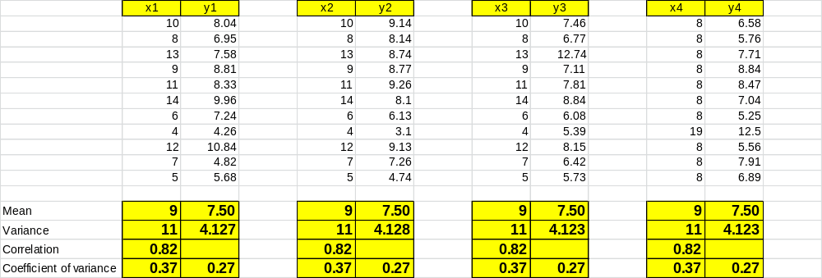
Example1: Are these all pairs the same?

Slide 5
Surprise !!!
All the summary statistics are same !!!
What should we conclude?
Are these pairs the same?
Now let us try plotting these pairs

Slide 6
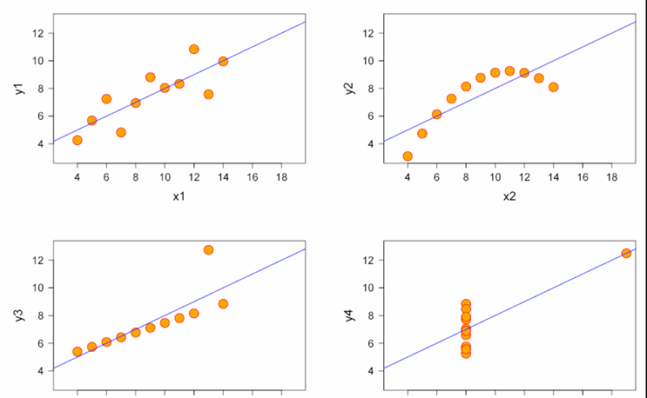
Example 1
Linear correlation
Anscombe's Quartet
Normally distributed | Not distributed normally; while an obvious relationship between the two variables can be observed, it is not linear, and the Pearson correlation coefficient is not relevant
The distribution is linear, but with a different regression line, which is offset by the one outlier which exerts enough influence to alter the regression line and lower the correlation coefficient from 1 to 0.81 | One outlier is enough to produce a high correlation coefficient, even though the relationship between the two variables is not linear.

Slide 7
Example 1: What did this tell us?
Was it just a plain coincidence?
Was the data constructed to get the same results?
If we get similar results from multiple clinical trials then how to react to?
Anscombe's Quartet: to demonstrate both the importance of graphing data before analyzing it and the effect of outliers on statistical properties.

Slide 8
What are the key steps of conducting an experiment
Rationale of the experiment
Primary objective to achieve at the end of the experiment
Inclusion/Exclusion criteria
Statistical methods to design the study
Data collection & statistical methods to analyze the data
Interpretation
Use of the results in subsequent experiments/ extrapolation (internal / external validity)

Slide 9
Example 2:
HEADLINE in a NEWS paper
NRIs in US earn more than natives
What are you thinking?
What will be your reaction?

Slide 10
Example 2:
HEADLINE in a NEWS paper
NRIs in US earn more than natives
Oh wow, a very good news
But hold on...
Is this just another “Breaking News”?
What is the basis of this Headline?
Is this authentic?

Slide 11
1. What is the Rationale of the experiment
Now start thinking about this as an experiment
What are we going to get out of it?
Comparison of salaries for the Americans
Reality check
Is this going to be used for the economic policies?
– reality check of AS IS situation
– development of future policies
One more economic indicator

Slide 12
Example 2:
HEADLINE in a NEWS paper
NRIs in US earn more than natives
Let us add some more data,
What is getting compared:
Salaries for | NRIs in USA | Americans in USA
 | $60,093 | $38,885
Population | 1.68 millions | 296 millions
Very small section in the whole country vs. the whole country

Slide 13
2. Primary objective to achieve at the end of the experiment
What is the primary question getting answered?

Slide 14
3. Inclusion/Exclusion criteria
Who were asked for their salary information?
Was it a survey? Or
Was the salary information obtained from the employers?
Was there an option given to opt out of the survey, if it was a survey?
Once the information was available, did some data get excluded?
Are the results going to be biased due to selection?
Did they go to all the Americans for the data? Census?
How did they choose on the sample?
Was it representative enough for the whole of the country?

Slide 15
4. Statistical methods to design the study
What kind of a design?
Was it a Survey?
Census
Sampling (convenient sampling, systematic sampling)
Open label study – the participants would have known the reasons for participation

Slide 16
Example 2:
HEADLINE in a NEWS paper
NRIs in US earn more than natives
Let us add some more data,
What is getting compared: this data was collected in year 2000
Salaries for | NRIs in USA | Americans in USA
 | $60,093 | $38,885
Population | 1.68 millions | 296 millions
Very small section in the whole country vs. the whole country

Slide 17
5. Data collection & statistical methods to analyze the data
How to collect the data?
Background of participants
Education,
Number of years of experience,
Gender,
Age,
Type of occupation
Year 2000, the time for Y2K problem and a lot of IT companies were hiring programmers to fix the problem – is this one of the not so normal year to look at the salaries?
Did everyone contribute the correct information?
Validity of the data

Slide 18
5. Data collection & statistical methods to analyze the data, cont’d
Now start analyzing:
Who would typically go to the US from India and find jobs?
Students who have earned American degrees
  IITians
  IIM graduates
  Masters/PhDs
Mostly we are talking about “people with above average IQ”
All of the Americans are certainly not above average IQ.
Background is not truly comparable.

Slide 19
6. Interpretation
NRIs are doing well in their adopted country
Adopted country is treating them well
Is this a fair comparison? OR was this an obvious result?

Slide 20
7. Use of the results in subsequent experiments
As a researcher someone can come up with the following question:
To better understand the IT space and the salaries involved in USA

Slide 21
Thank you !!!

Slide 22
An outline of points to consider while conducting a clinical trial
Back-up
Background
Study rationale
Objectives
Study design
Population
Treatment
Visit schedule and assessment details
Safety monitoring
Data management activities
Statistical methods and data analysis
Administrative procedures
Protocol compliance
References

Slide 23
Example 2:
Economic Times
NRIs in US earn more than natives
TNN Jul 6, 2005, 01.56am IST
Back-up
NEW DELHI: Average per capita income of Indians in the US is $60,093 as per the US census of 2000. The more remarkable fact about this figure is that it stands against the US average of $38,885 in the same census.
This is revealed in a World Bank study on India and its knowledge industry released last week. The study also captures the trends of Indian Diaspora in the United States and elsewhere.
The World Bank report quoting the US census of 2000 says that Indian Americans also have an edge over their American counterparts in the field of education. with more than 62% of them having some college education (compared with just more than 20% for the US population).
http://articles.economictimes.indiatimes.com/2005-07-06/news/27509472_1_indian-american-community-census-nris

Slide 24
Example 2:
Economic Times
NRIs in US earn more than natives
TNN Jul 6, 2005, 01.56am IST
Cont’d
Back-up
While they have spread their wings in virtually all professions including agriculture, biotechnology, business, economics, finance, journalism, management, medicine their presence is highly prominent in the IT industry of the USA: approximately 300,000 Indian-Americans work in Silicon Valley, account for more than 15% of start-ups in the USA, and have an average annual income of about $200,000.
The Indian Diaspora in the US is not only growing wealthy but also rapidly. The Indian American community now boasts of 1.68 million people compared with 0.81 million in 1990-a growth of 106%.
http://articles.economictimes.indiatimes.com/2005-07-06/news/27509472_1_indian-american-community-census-nris

Slide 25
References
Google: Anscombe's Quartet
http://articles.economictimes.indiatimes.com/2005-07-06/news/27509472_1_indian-american-community-census-nris

